Slide 1
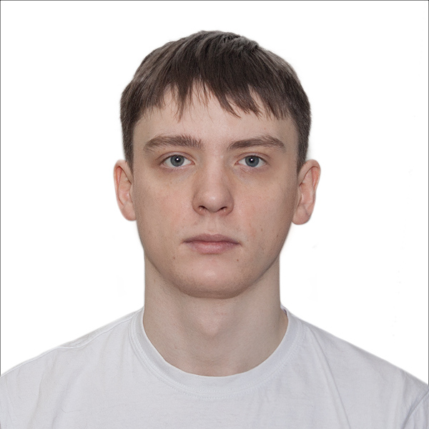
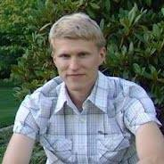
Badger Rampage: Multi-Dimensional Balanced Partitioning of Facebook-scale Graphs
Grigory Yaroslavtsev
(Indiana University, Bloomington)
http://grigory.us/blog
Dmitry Avdyukhin (Indiana University), Sergey Pupyrev (Facebook)
2nd Workshop on Local Algorithms, MIT, June 14, 2018

Slide 2
“Three Schools of Thought” in Algorithms & Complexity
Boston (MIT & Harvard)
Youthful & innovative attacks on problems, driven by PhD students with new ideas (“grad student descent”)
“Relentless optimism ;)”: faster algorithms, e.g. sublinear time, gradient descent, unconditional results

Slide 3
“Three Schools of Thought” in Algorithms & Complexity
New York & Chicago (Princeton, NYU, U Chicago)
Abstract and skeptical theory building, driven by fundamental questions and big agendas
“Life is hard…”: polynomial-time, hardness of approximation, conditional hardness, beyond-worst case analysis

Slide 4
“Three Schools of Thought” in Algorithms & Complexity
Bay area (Stanford & Berkeley)
No time for philosophy, driven by applications and societal needs
“Let’s start a company and change the society!”: machine learning/AI, fairness, social networks, privacy

Slide 5
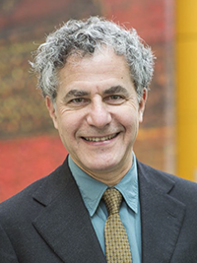
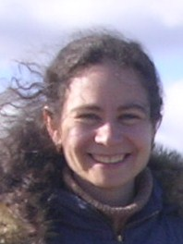
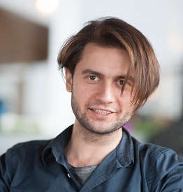
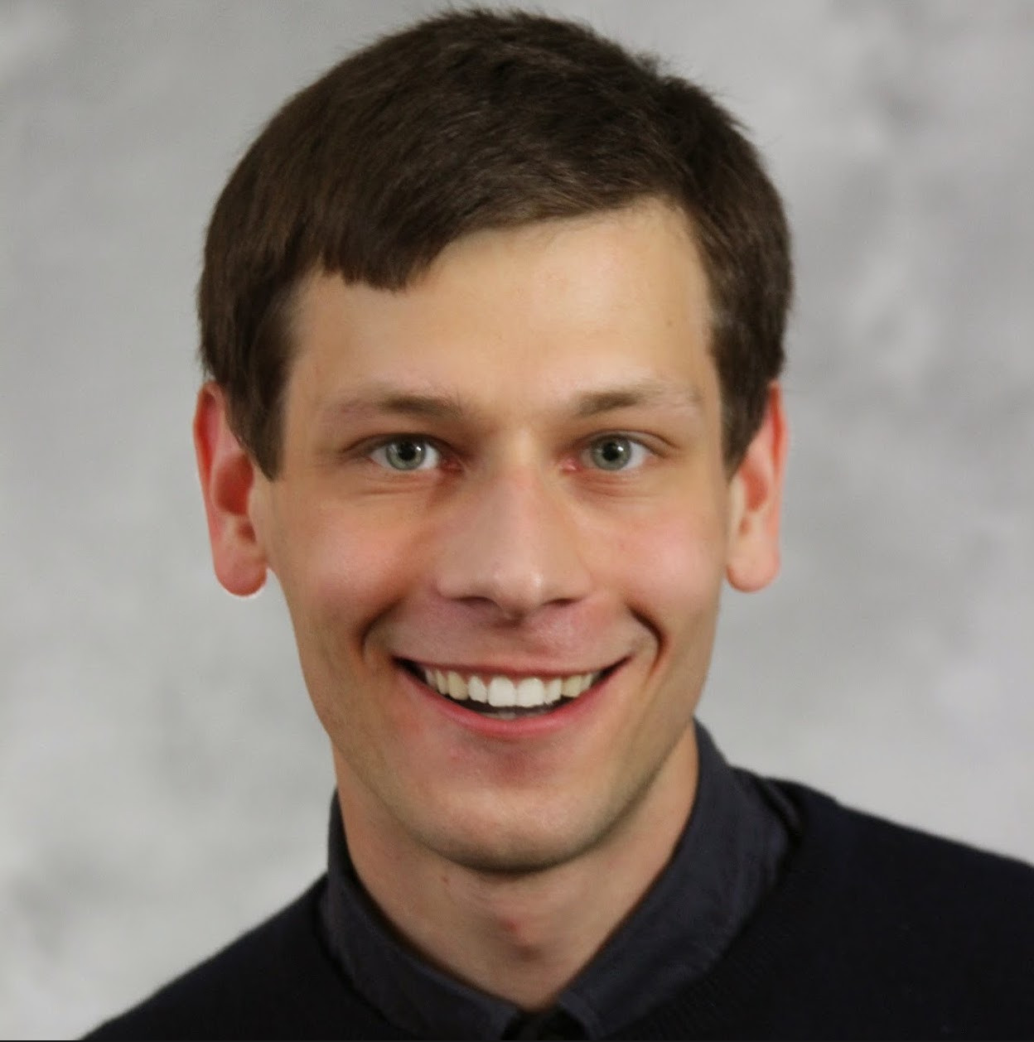
This talk
“Boston school”
Fast, optimistic and specific: sublinear time, streaming, distributed, gradient descent
“Bay area school”
Driven by applications, does it work in practice and scale to large data?
⬇
⬇
⬇

Slide 6
Balanced Graph Partitioning
Partition $G(V,E)$ into $k$ parts $V_{1},V_{2},…,V_{k}$:
Each part contains $(1±ε)\frac{\left|V\right|}{k}$ vertices
# of edges inside the parts is maximized
Goal: make it work for the real Facebook graph
Load balancing
Community detection
Selecting representative subsets for training
…

Slide 7
Facebook Graph
# vertices $≈2 ×{10}^{9},$ #edges $≈{10}^{12}$

Slide 8
Hard in Theory, Important in Practice
Minimizing the cut
No constant-factor approximation for $ε=0, k≥3$ unless P = NP [Andreev, Racke’06]
Best approximation: polylog [Feige, Krauthgamer’02]
Max n/2-UNCUT
$≈$0.64 via SDP [Halperin, Zwick, IPCO’01]
If approximate balance is allowed, what is the hardness of this problem?

Slide 9
Hard in Theory, Important in Practice
Previous generation tools:
METIS [Karypis, Kumar, ‘95]
Google:
Linear embedding: [Aydin, Bateni, Mirrokni, WSDM’16]
Facebook:
Label propagation: [Ugander, Backstrom, WSDM’13]
SocialHash partitioner: [Kabiljo, Karrer, Pundir, Pupyrev, Shalita, Akhremtsev, Presta, VLDB’17]
Spinner [Martella, Logothetis, Loukas, Siganos, ICDE’17]
Some other papers:
FENNEL [Tsourakakis, Gkantsidis, Radunovic, Vojnovic, WSDM’14]

Slide 10
Multidimensional Balanced Graph Partitioning
Balance according to multiple weights ($≥0$)
Each vertex $i$ has $d$ weights: $w_{i,1}, w_{i,2},…,w_{i,d}$
L$et w_{j}\left(S\right)=\sum_{i∈S}{w_{ij}}$ for each $j∈[d]$
Want $w_{j}\left(V_{t}\right)=\frac{\left(1±ε\right)w_{j}(V)}{k}$ for each part $V_{t}$
Balanced graph partitioning: $d=1, ∀i:w_{i1}=1$
Balance of the sum of degrees in each part: $w_{i2}=deg⁡(i)$
Note: can be impossible as weights are unrelated

Slide 11
Existing approaches are combinatorial
Local search, branch and bound, “linear embedding”, etc …
Difficult to extend to the multi-dimensional case
Don’t scale very well
Don’t produce good results
Our approach is gradient descent based:
Easy to implement
Scales well on Facebook-scale graphs
Handles multiple balance constraints naturally

Slide 12
Quadratic Integer Program
Variable $x_{i}$ for each vertex:
$i∈V_{1}$: $x_{i}=1$
$i∈V_{2}$: $x_{i}=−1$
$$x_{i}=1$$
$$x_{i}=−1$$
Maximize: $\sum_{\left(i_{1},i_{2}\right)∈E}{ \frac{1}{2}\left(x_{i_{1}}x_{i_{2}}+1\right) }$
Subject to: $\left|\sum_{i=1}^{n}{w_{ij}x_{i}}\right|≤ε\sum_{i=1}^{n}{w_{ij}} ∀j∈[d]$
$x_{i}∈\left\{−1,1\right\} ∀i∈V$

Slide 13
Non-convex relaxation
$x_{i}$ $→$ continuous variables
$$x_{i}∈[−1,1]$$
Maximize: $\sum_{\left(i_{1},i_{2}\right)∈E}{ \frac{1}{2}\left(x_{i_{1}}x_{i_{2}}+1\right) }$
Subject to: $\left|\sum_{i=1}^{n}{w_{ij}x_{i}}\right|≤ε\sum_{i=1}^{n}{w_{ij}} ∀j∈[d]$
$x_{i}∈[−1,1] ∀i∈V$

Slide 14
Randomized Projected Gradient Descent
Objective: $f\left(x\right)=x^{T}A x$ (up to constants)
$∇f\left(x\right)=Ax, ∇^{2}f\left(x\right)=A$
Projected Gradient Descent
Set $x_{0}=0$
For $i=1… t:$
Gradient step: $y_{i}=x_{i}+γ⋅∇f\left(x_{i}\right)= x_{i}(I+γA)$
Project on the feasible space: $x_{i+1}=Proj(y_{i})$
Note that $x_{0}=0$ is a saddle point
Add random noise: $x_{i}^{′}=x_{i}+N_{d}(0,1)$

Slide 15
Projection Step
Proj($y_{i}$) is $x$ = closes$t^{∗}$ point to $y_{i}$ satisfying:
$$\left|\sum_{i=1}^{n}{w_{ij}x_{i}}\right|≤ε\sum_{i=1}^{n}{w_{ij}} ∀j∈[d]$$
$x_{i}∈[−1,1] ∀i∈V$
${}^{∗}$ closest in $ℓ_{2}$ (Euclidean distance)
Projection is a computationally expensive step
For $d=1$ can be done in $O(n)$ time [Maculan, et al. ‘03]
For $d=2$ we give an $O(n\log^{2}{n})$ time algorithm
Open: Give $\tilde{O}(n)$ time algorithm for any fixed $d$

Slide 16
Badger Rampage: BalAnceD GRaph Partitioining via RAndoMized Projected Gradient DEscent
Set $x_{0}=0$
For $i=1… t:$
Gradient step: $y_{i}={(x}_{i}+N_{d}(0,1))⋅(I+γA)$
Project on the feasible space: $x_{i+1}=Proj(y_{i})$
${}^{∗}$If fractional values remain, use them as rounding probabilities
Open: What can we say about convergence?
Randomized PGD converges to a local minimum if all constraints are equalities [Ge, Huang, Jin, Yuan, COLT’15]
With inequalities even computing Frank-Wolfe conditional gradient is NP-hard

Slide 17
Projection Problem
Feasible region: $B_{∞}∩\left(\bigcap_{j=1}^{d}{S_{ε}^{j}}\right)$, where:
$ℓ_{∞}$-ball${ B}_{∞}=\left\{x∈R^{n} \right| x_{i}∈[−1; 1]\}$
Slice $S_{ε}^{j}=\left\{x∈R^{n} \right| \left|\sum_{i=1}^{n}{w_{ij} x_{i}}\right| ≤ε\sum_{i=1}^{n}{w_{ij}}\}$
Approaches:
Solve exactly using KKT conditions
Alternating projections: $P_{B_{∞}}(P_{S_{ε}^{1}}(P_{S_{ε}^{2}}(…P_{S_{ε}^{d}}(P_{B_{∞}}(…\left(y\right)…)$
Finds a point in the feasible space, not necessarily closest
Dykstra’s projection algorithm
Converges to the projection

Slide 18
Projection problem
Minimize: $f\left(x\right)= |\left|x −y\right|{\left.​\right|}_{2}^{2}$
Subject to:
$${ x}_{i}^{2} ≤1 ∀i∈\left[n\right]$$
$$\sum_{i=1}^{n}{w_{ij}x_{i}≤c ∀j∈[d]}$$
$$\sum_{i=1}^{n}{w_{ij}x_{i}≥−c ∀j∈[d]}$$

Slide 19
After simplifying KKT conditions…
KKT is equivalent to finding $λ_{1}, …,λ_{d}$ such that $x$ satisfies the constraints, where
$x_{i}={[y}_{i} − \sum_{j}{λ_{j}w_{ij}], }$ where [] is rounding to [-1,1]
I.e. shift $y$ by a lin. combination, then project on $B_{∞}$
$x$ is the projection if it satisfies constraints:
$λ_{j}<0⇒\sum_{i}{w_{ij}x_{i}}=c$
$λ_{j}=0⇒\sum_{i}{w_{ij}x_{i}}∈\left[−c, c\right]$
$λ_{j}>0⇒\sum_{i}{w_{ij}x_{i}}=−c$

Slide 20
Finding $λ_{1},…,λ_{d}$
For each $j$ there are $3$ cases:
$λ_{j}<0⇒\sum_{i}{w_{ij}x_{i}}=c$
$λ_{j}=0⇒\sum_{i}{w_{ij}x_{i}}∈\left[−c, c\right]$
$λ_{j}>0⇒\sum_{i}{w_{ij}x_{i}}=−c$
Try $3^{d}$ combinations. Select the best point
For each unknown $λ_{j}$ we have equality constraints
Projection on $B_{∞}∩\left(∩_{i=1}^{d}A_{i}\right),$ where $A_{i}$ are hyperplanes
Can find $λ_{1},…,λ_{d}$ using nested binary search
$O(n\log{n})$ for $d=1$ and $O(n\log^{2}{n})$ for $d=2$
Conjecture: $\tilde{O}(n)$ for any fixed $d$

Slide 21
Balanced Graph Partitioning
Implementation in Apache Giraph
Percentage of cut edges on subsets of the Facebook graph (allowed vertex imbalance – 3%).
Graph | Badger Rampage | SocialHash | Spinner
FB-2.5B | 5.11% | 8.75% | 13.30%
FB-55B | 4.99% | 11.75% | 12.79%
FB-80B | 5.21% | 12.04% | 8.64%
FB-400B | 6.88% | 5.82% | 6.31%
FB-800B | 5.52% | 5.25% | 6.83%

Slide 22
2D Balanced Graph Partitioning
Percentage of cut edges on public graphs (allowed imbalance on vertices and degrees – 1%).
Graph | Badger Rampage– exact projection | Badger Rampage – alternating projection | Spinner
LiveJournal | 6.74% | 6.74% | 9.53%
Orkut | 5.14% | 4.9% | 5.68%
ego-Gplus | 12% | 12.2% | 44.5%

Slide 23
Step size selection ($γ$)
Cut size per iteration as a function of $γ$

Slide 24
Future work
$\tilde{O}(n)$ algorithm for fixed $d$?
Guarantees on convergence of Badger Rampage?
Practical algorithm for more than $2$ parts
Currently use recursive partitioning
Can modify the approach to support $k$ parts, but time and memory increase by factor $k$

